Slide 1
INTRODUCTION TO COMPUTERS

Slide 2
Overview
Introductory definitions
Components of a computer
Parts of a computer
Exploring the desktop
Files and Folders

Slide 3
Computer
An electronic device that processes data according to a set of stored instructions.
An electronic device that follow instructions to accept input (data), process the input and then produce output (information).
Work through an interaction of hardware and software
Hardware - the physical parts of a computer that you can see and touch.
Software refers to programs that governs the operations of the computer.

Slide 4
Parts of a computer
Hardware
Physical parts of a computer that you can see and touch
E.g. Monitor (screen), keyboard, mouse etc.
Internal hardware is found inside the main box of the computer
External hardware is found outside the system unit and plug into ports located on the exterior of the system unit.
Software
Programs that control or maintain the operations of the computer and its devices.
Instructions or programs that perform actions on a hardware

Slide 5
Software
Two types:
1. Systems software
Programs that control or maintain the operations of the computer and its devices. Sub-divided into two:
Operating Systems (OS): is a set of programs that coordinates all activities among computer hardware devices and allows users to run application software e.g. Windows, Linux, Macintosh, Android etc
Utility programs: allow the user to perform maintenance-type tasks usually related to managing a computer, its device or its program e.g. Virus scanner, disk defragmenters, backup software, etc.

Slide 6
Software cont…
2. Applications software
Programs that perform specific tasks for users. Enable users to solve problems, perform work or entertain themselves.
Examples:
Word processor e.g. Microsoft Word
Spreadsheet e.g. Microsoft Excel
Presentation e.g. Microsoft PowerPoint
Viewing Web pages
Sending and receiving e-mail

Slide 7
Components of a computer
An input (device) is a hardware used to enter data into the computer
An output (device) is a hardware that conveys information to the user
A Central Processing Unit (CPU) or processor changes data into information
Memory
A storage stores data or information

Slide 8
Input devices
Any device that enables users to enter data and instructions into the computer
Keyboard
Used to type information into your computer
Mouse
Allows data input by clicking to select options
Scanners
Barcode readers
Digital camera
Microphone

Slide 9
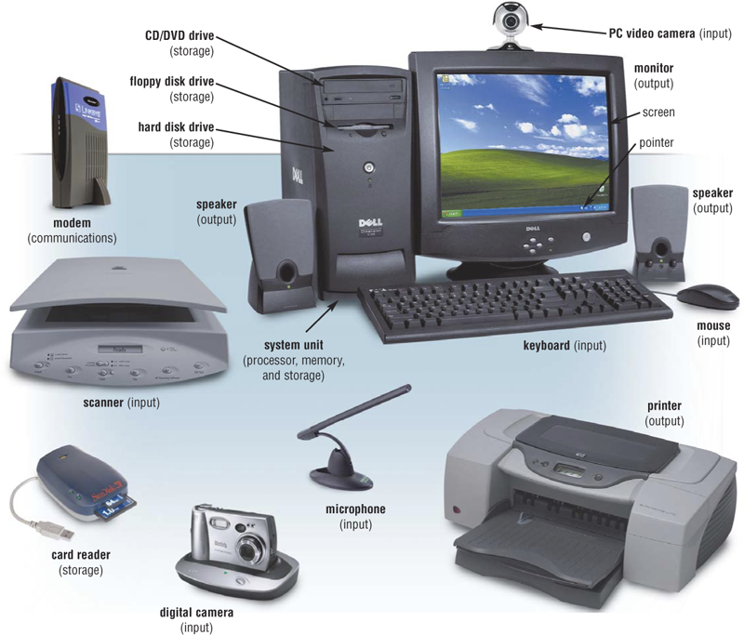
Input Devices
Hardware used
to enter data
and instructions

Slide 10
Output devices
Any device that help users get information out of the computer in a meaningful way.
Monitor, screen or Visual Display Unit (VDU)
Cathode Ray Tube (CRT)
A vacuum tube used as a display screen in a computer or video display terminal.
Found in older desktop computers but also in older television sets.
Liquid Crystal Display (LCD)
A flat panel technology
Printers
Speakers
To deliver an audio output such as music, that is connected to the computer.

Slide 11
Output devices
Hardware that
conveys information to a user

Slide 12
Storage devices
Holds data, instructions, and information for future use
Examples of storage devices are:
Hard disk drive
Compact disks
Memory card
Flash disks

Slide 13
Memory
Temporary holding place for data and instructions.
Where programs and data are kept when the processor is actively using them.
Special chips that hold data and instructions ready for use by the CPU.
Types of Memory
RAM (Random Access Memory)
ROM (Read Only Memory)

Slide 14
Random Access Memory (RAM)
Also referred to as Main memory
Holds the programs and data that users are working on.
Temporarily hold (1) software instructions and (2) data before and after it is processed by the CPU.
RAM is volatile – when the computer is switched off anything in RAM is lost.
Data stored on disk is transferred into RAM when you open a file to work on it.

Slide 15
Read Only Memory (ROM)
Memory that stores instructions and data that can be only be read, but it cannot be updated or modified.
Modifying it is either impossible or very difficult.
Important program instructions needed to start a computer and load OS are stored in ROM.
ROM is non-volatile storage, which means that the information is maintained even if the component loses power.
ROM plays a critical part in starting up the computer.
This is also referred to as booting up the computer.

Slide 16
Central Processing Unit (CPU)
Also called the processor or microprocessor.
A part of a computer that controls all other parts.
CPU interprets and carries out the basic instructions that operate a computer.
Directs and coordinates most of the operations in a computer
Carries out instructions that tell the computer what to do.
Considered to be the brain of the computer.

Slide 17
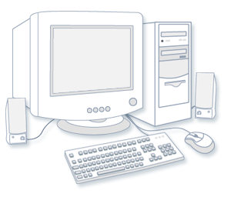
Types of computers
Desktop computers (personal Computer
Designed for use at a desk or table
Designed so all of the components fit on or under a desk or table

Slide 18
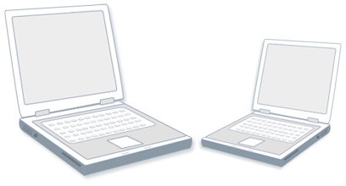
Types of computers
Laptops and notebooks
Lightweight mobile computers with a thin screen.
Can operate on batteries, so you can take them anywhere.
Unlike desktops, laptops combine CPU, screen, and keyboard in a single case
Notebooks are small, affordable laptops that are designed to perform a limited number of tasks such as to browse the web and check e‑mail.

Slide 19

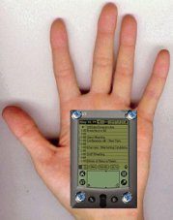
Types of computers
Handheld computers (Palmtops)
Also called personal digital assistants (PDAs)
Are battery-powered computers small enough to carry almost anywhere.
Useful for scheduling appointments, storing addresses and phone numbers, and playing games.
Some have more advanced capabilities, such as making telephone calls or accessing the Internet.
Have touch screens that you use with your finger or a stylus (a pen-shaped pointing tool).

Slide 20
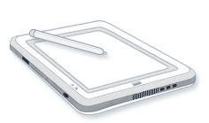
Types of computers
Tablet PCs
Mobile computers that combine features of laptops and handheld computers.
Users write notes or draw pictures on the screen with a tablet pen instead of a stylus.
Can also convert handwriting into typed text.
Some Tablet PCs are “convertibles” with a screen that swivels and unfolds to reveal a keyboard underneath.

Slide 21

Types of computers
Smartphones
Are mobile phones that have some of the same capabilities as a computer.
Used to make telephone calls, access the Internet, organize contact information, send e‑mail and text messages, play games and take pictures.
Usually have a keyboard and a large screen.

Slide 22
Types of computers
Server
A computer that has been optimized to provide services to other computers over a network.
Servers have powerful processors, lots of memory and large hard drives.
Other types of computers can fill an entire room.
These are: Mainframes and Supercomputers

Slide 23
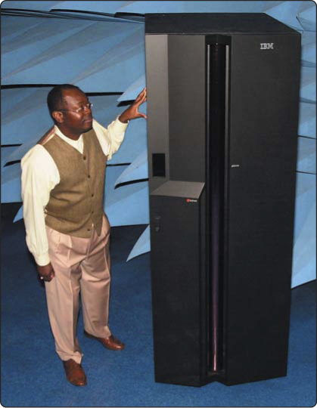
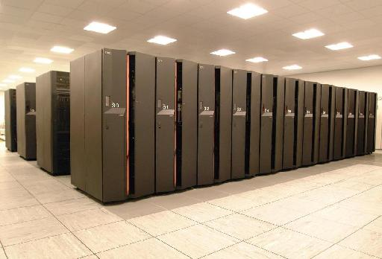
Servers
Midrange server Powerful, large computer that supports up to a few thousand computers
Mainframe Very powerful, expensive computer that supports thousands of computers
Supercomputer The fastest, most powerful, most expensive computer. Used for applications requiring complex mathematical calculations

Slide 24
What can you do with computers?
At workplace, people use computers to keep records, analyze data, do research, manage projects etc.
At home, people use computers to find information, store pictures and music, track finances, play games and communicate with others.
Connect to the Internet etc.

Slide 25
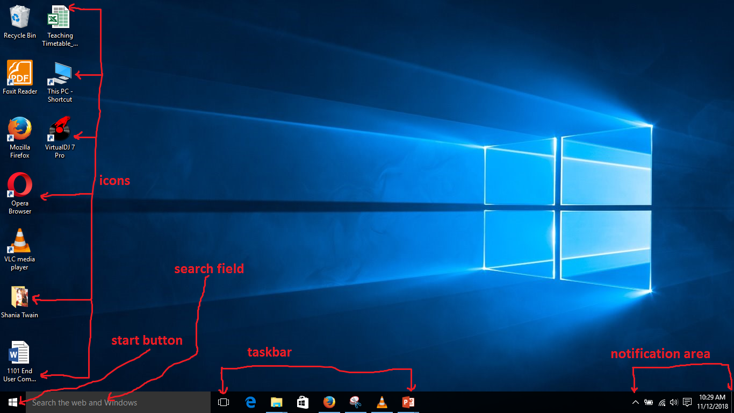
Exploring the desktop in windows 10

Slide 26
The desktop
The main screen area that you see after you turn on your computer and log on to Windows.
It serves as a surface for your work.
When you open programs or folders, they appear on the desktop.
You can put things on the desktop, such as files and folders and arrange them the way you want.
The taskbar sits at the bottom of your screen.
It shows you which programs are running and allows you to switch between them.
It also contains the Start button , which you can use to access programs, folders and computer settings.

Slide 27
Using the mouse
An input device used to enter data and instructions into the computer
You can use the mouse to interact with items on the computer screen.
You can move objects, open them, change them, throw them away, and perform other actions, all by pointing and clicking with the mouse.

Slide 28
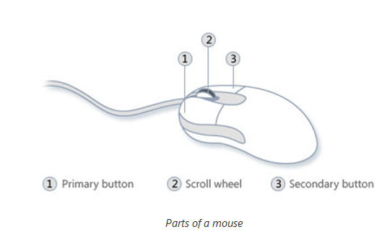
Using the mouse
Basic parts
A mouse has two buttons:
a primary button (usually the left button) and
a secondary button (usually the right button).
Primary button is mostly used.
Most mice also include a scroll wheel between the buttons to help users scroll through documents and webpages more easily.

Slide 29
Basic mouse terminology
Left-Click: Pressing the left button of the mouse once.
Used for selecting icons and opening programs.
Right-Click: Pressing the right button of the mouse once.
Used for opening contextual menus.
Single-Click: Clicking once (with the left mouse button) on the icon to select the icon.
Double-Click: Clicking twice (with the left mouse button) on the icon to activate the icon.
Activating the icon will run the program or open the file that is associated with the icon.

Slide 30
Basic mouse terminology
Drag/Drag-and-Drop: This is used to move files around on the computer.
It may also be used to copy files from one location to another eg hard drive to flash drive
To drag a file, left-click and hold down the button, move the icon to the new location and let go of the mouse button.

Slide 31
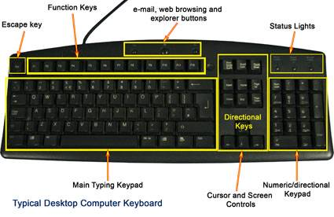
Keyboard
Keyboard is the main way to enter information into the computer.
You can also use the keyboard to control the computer.

Slide 32
Keyboard keys
The keys on the keyboard can be divided into several groups based on function:
Typing (alphanumeric) keys. These keys include the same letter, number, punctuation, and symbol keys found on a traditional typewriter.
Control keys - These keys are used alone or in combination with other keys to perform certain actions. The most frequently used control keys are Ctrl, Alt, the Windows logo key and Esc.
Function keys. The function keys are used to perform specific tasks. They are labeled as F1, F2, F3 and so on, up to F12. The functionality of these keys differs from program to program.
Navigation keys - These keys are used for moving around in documents or webpages and editing text. They include the arrow keys, Home, End, Page Up, Page Down, Delete, and Insert.
Numeric keypad - The numeric keypad is handy for entering numbers quickly. The keys are grouped together in a block like a conventional calculator or adding machine.

Slide 33
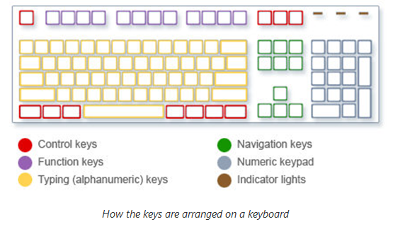
Keyboard keys
The following illustration shows how these keys are arranged on a typical keyboard. Some keyboard layout might be different.

Slide 34
Press this | To do this
Left Arrow, Right Arrow, Up Arrow, or Down Arrow | Move the cursor or selection one space or line in the direction of the arrow, or scroll a webpage in the direction of the arrow
Home | Move the cursor to the beginning of a line or move to the top of a webpage
End | Move the cursor to the end of a line or move to the bottom of a webpage
Ctrl+Home | Move to the top of a document
Ctrl+End | Move to the bottom of a document
Page Up | Move the cursor or page up one screen
Page Down | Move the cursor or page down one screen
Delete | Delete the character after the cursor, or the selected text; in Windows, delete the selected item and move it to the Recycle Bin
Insert | Turn Insert mode off or on. When Insert mode is on, text that you type is inserted at the cursor. When Insert mode is off, text that you type replaces existing characters.

Slide 35
Key name | How to use it
Shift | Press Shift in combination with a letter to type an uppercase letter. Press Shift in combination with another key to type the symbol shown on the upper part of that key.
Caps Lock | Press Caps Lock once to type all letters as uppercase. Press Caps Lock again to turn this function off. Your keyboard might have a light indicating whether Caps Lock is on.
Tab | Press Tab to move the cursor several spaces forward. You can also press Tab to move to the next text box on a form.
Enter | Press Enter to move the cursor to the beginning of the next line. In a dialog box, press Enter to select the highlighted button.
Spacebar | Press the Spacebar to move the cursor one space forward.
Backspace | Press Backspace to delete the character before the cursor, or the selected text.

Slide 36
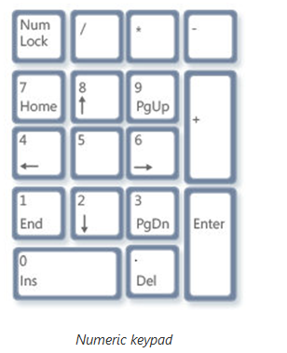
Using the numeric keypad
The numeric keypad arranges the numerals 0 though 9, the arithmetic operators + (addition), - (subtraction), * (multiplication), and / (division), and the decimal point as they would appear on a calculator or adding machine.
These characters are duplicated elsewhere on the keyboard, but the keypad arrangement allows you to quickly enter numerical data or mathematical operations with one hand.

Slide 37
Using the numeric keypad
To use the numeric keypad to enter numbers, press Num Lock.
Most keyboards have a light that indicates whether Num Lock is on or off.
When Num Lock is off, the numeric keypad functions as a second set of navigation keys (these functions are printed on the keys next to the numerals or symbols).
You can use numeric keypad to perform simple calculations with Calculator.

Slide 38
Typing text
Whenever you need to type something in a program, e‑mail message or text box, you'll see a blinking vertical line (I).
That's the cursor also called the insertion point.
It shows where the text that you type will begin.
You can move the cursor by clicking in the desired location with the mouse, or by using the navigation keys.
In addition to letters, numerals, punctuation marks, and symbols, Typing keys also include Shift, Caps Lock, Tab, Enter, the Spacebar and Backspace.

Slide 39
Working with windows
When you open a program, file or folder, it appears on the screen in a box or frame called a window
(that's where the Windows operating system gets its name).
A window is a rectangle on your screen that organizes how you view and work in specific programs or files on your computer.
See the picture in the next slide.

Slide 40
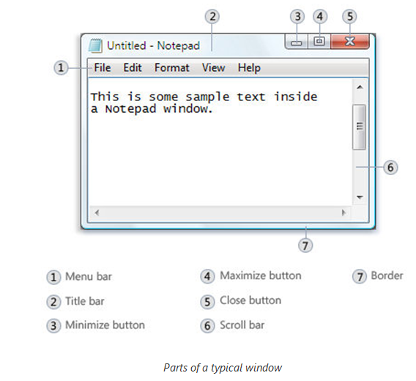
Working with windows
All windows share some things in common.
Windows always appear on the desktop—the main work area of your screen.
Most windows have the same basic parts.

Slide 41
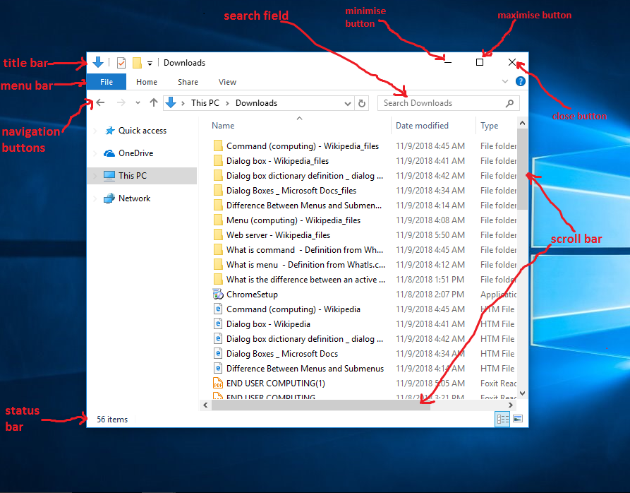
Working with windows

Slide 42
Parts of a window
Title bar - Displays the name of the document and program (or the folder name if you're working in a folder).
Minimize, Maximize, and Close buttons. These buttons hide the window, enlarge it to fill the whole screen, and close it, respectively
Menu bar - Contains items that the can click to make choices in a program.
Scroll bar – Help users to scroll the contents of the window to see information that is currently out of view.
Borders and corners - You can drag these with your mouse pointer to change the size of the window.
Other windows may have additional buttons, boxes, or bars. But they'll usually have the basic parts, too.

Slide 43
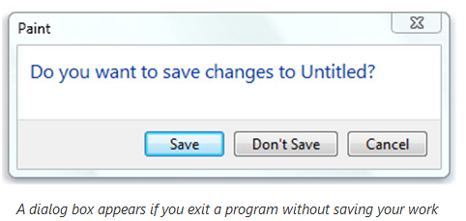
Dialog Boxes
A special type of window that ask users a question,
Allows users to select options to perform a task, or provides users with information.
You'll see dialog boxes when a program or Windows needs a response from the user before it can continue.
Most dialog boxes can't be maximized, minimized, or resized. They can, however, be moved.

Slide 44
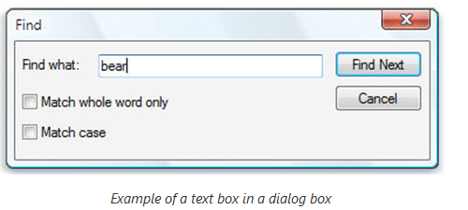
Using Text Boxes
A text box allow users to type information, such as a search term or password.
The following picture shows a dialog box containing a text box. We've entered "bear" into the text box.
A blinking vertical line called the cursor indicates where text that you type will appear. In the example, you can see the cursor after the "r" in "bear." You can easily move the cursor by clicking the new position. For example, to add a word before "bear," you would first move the cursor by clicking before the "b."
If you don't see a cursor in the text box, it means the text box isn't ready for your input. Click the box first, and then start typing.

Slide 45
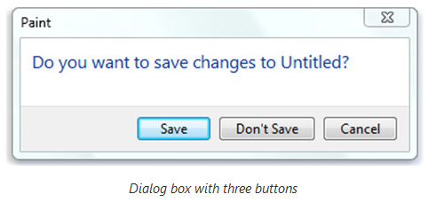
Using Command Buttons
A command button performs a command (makes something happen) when you click it.
You'll see them in dialog boxes, which are small windows that contain options for completing a task.
E.g. if you close a Paint picture without saving it first, you might see a dialog box like this.

Slide 46
Working with files and folders
A file is a document or collection of data that has a name and is stored in a computer
E.g. music, text, image, and video files
A folder is a directory used to store/organize your files
Files and folders help to keep your computer organized
Computer documents are saved as files
Folders are used to store/organize your files

Slide 47
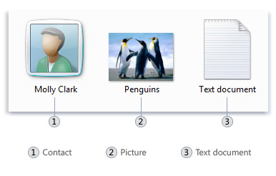
Working with files and folders
A file is an item that contains information—for example, text, images or music.
On computers, files are represented with icons; this makes it easy to recognize a type of file by looking at its icon.
The common way to create new files is by using a program.
E.g. you can create a text document in a word-processing program
Here are some common file icons:

Slide 48
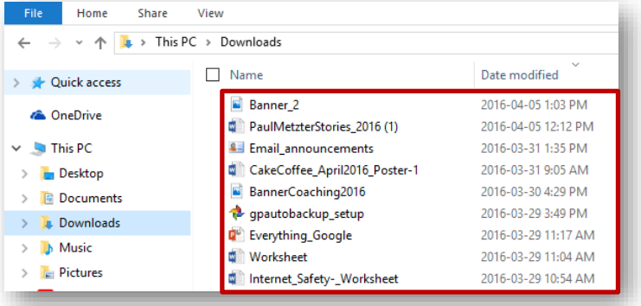
Files
Computer documents are saved as files (text, image, audio, video)
Examples of some files are:
A picture you saved/downloaded, a letter, a song or video you downloaded

Slide 49
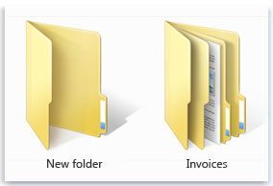
Folders
A folder is a container you can use to store files in.
Folders can also store other folders.
A folder within a folder is usually called a subfolder.
You can create any number of subfolders, and each can hold any number of files and additional subfolders.
Here are some typical folder icons:

Slide 50
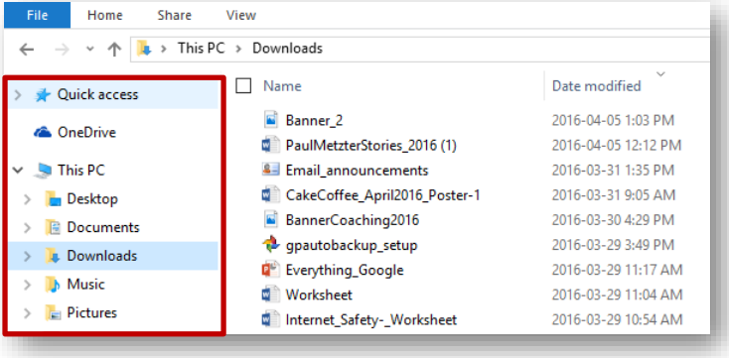
Folders
Folders are used to store your files. They are like File Cabinets, containing drawers, which contain file folders that can contain many documents.

Slide 51
Libraries
Windows Operating System has some folders already set up for you in your PC:
Documents
Music
Pictures
Videos
You can organize your own documents into these folders

Slide 52
Using libraries to access your files and folders
You can use libraries to access your files and folders, and arrange them in different ways.
Four default libraries and what they're used for:
Documents library.
Use to organize and arrange word-processing documents, spreadsheets, presentations, and other text-related files.
Pictures library.
Use to organize and arrange your digital pictures, whether you get them from your camera, scanner, or in e‑mail from other people..
Music library.
Use to organize and arrange your digital music, such as songs that you rip from an audio CD or that you download from the Internet.
Videos library.
Use to organize and arrange your videos, such as clips from your digital camera or video files that you download from the Internet.

